Slide 1

Face Mask Detection
Computer Vision project Professor Luigi Cinque Professor Marco Marini
Detect the wearing of masks used for COVID-19
Mona Kashani - 1911545 Behnoosh Bahavar - 1917707 Luis Mautone - 1875387

Slide 2
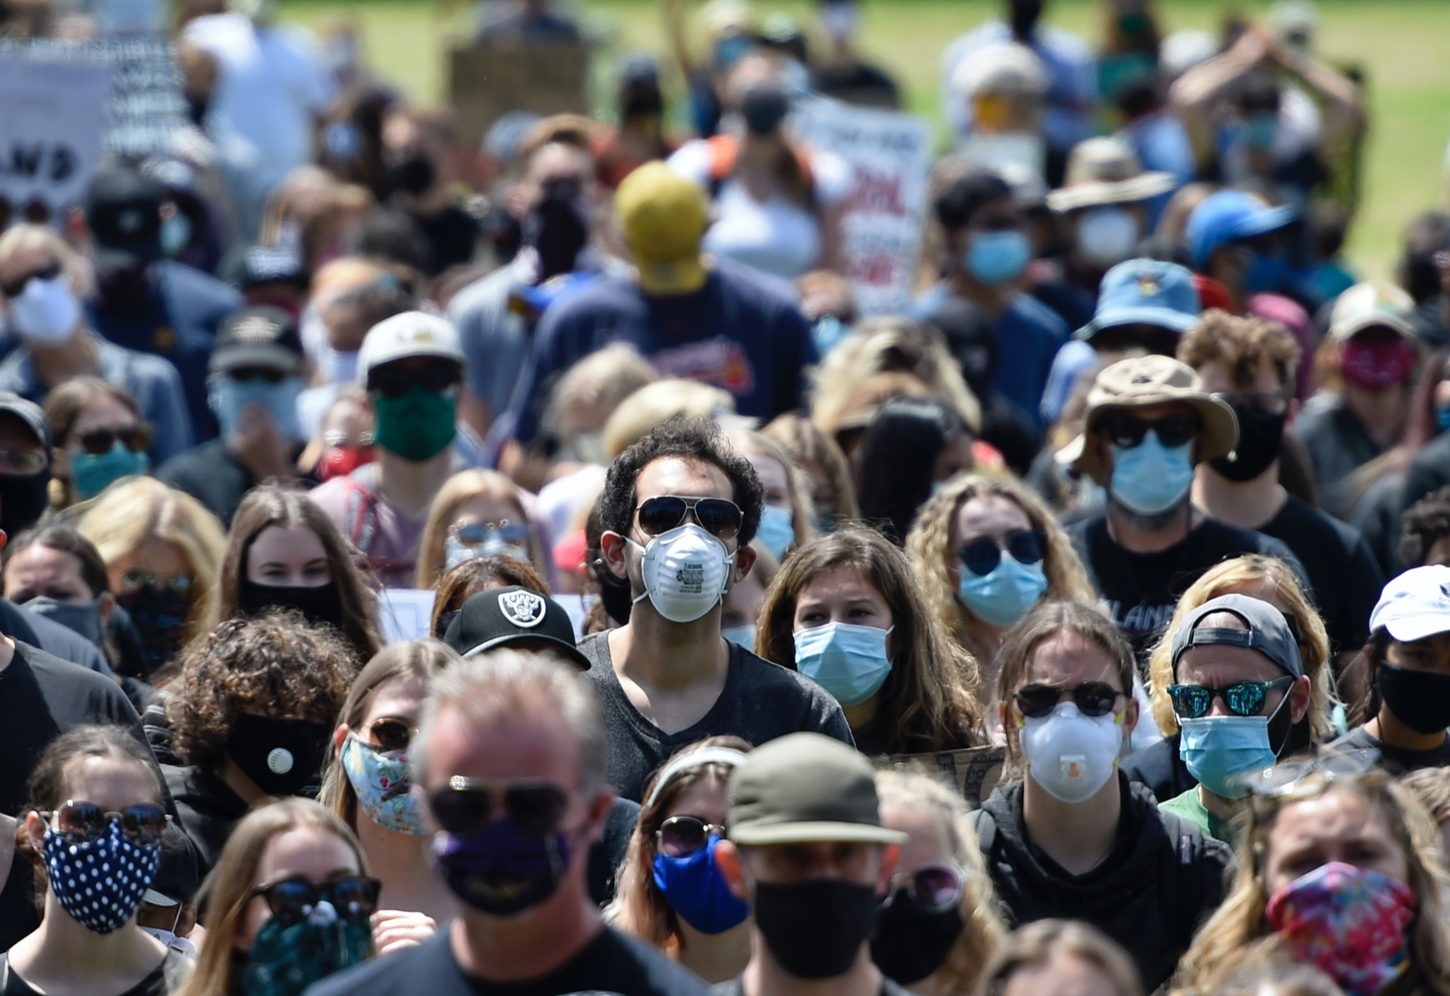
Why this topic?
Use of masks in public places has become a social obligation
Identification of masks ensures public safety
Need to improve face detectors based on facial cues
Collection of reliable statistics

Slide 3
The challenge
Detect faces, considering: - algorithms without handcrafted feature extraction - wild environment effects on data (noise, non-frontal, …) - occlusions of facial features due to masks
Predict the presence of masks, considering: - their visual diversity and appearances - their possible various orientations - the lack of many datasets since it is a recent problem

Slide 4
Our goals
Develop algorithm that: - detects faces - predicts presence of masks facing the explained issues
Exploit algorithm in an application - imagining a real use case

Slide 5
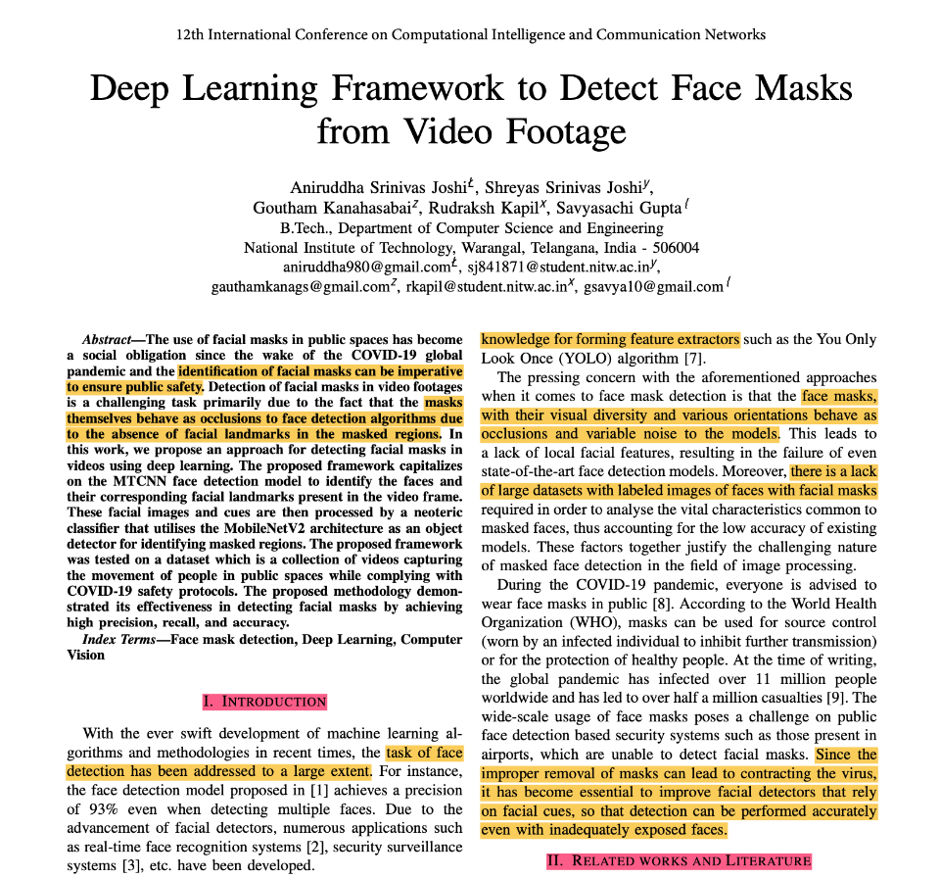
The proposed framework
[1]
Approach for detecting faces masks in videos using deep learning
First detect face of the person
Then determine if a mask is present

Slide 6
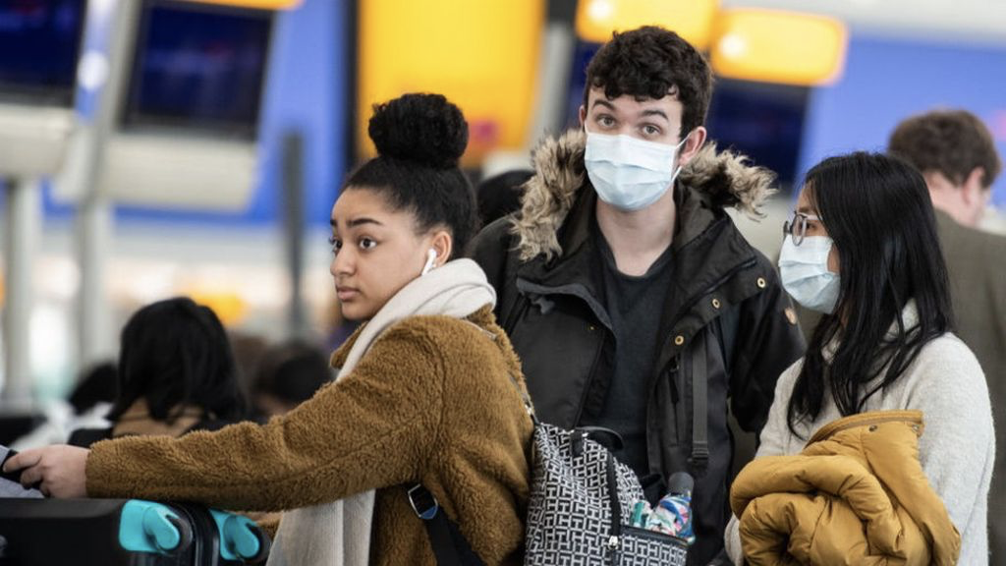
The proposed framework
Face detection with MTCNN model

Slide 7
The proposed framework
Mask prediction utilizing MobileNetV2 architecture
with mask
without mask

Slide 8
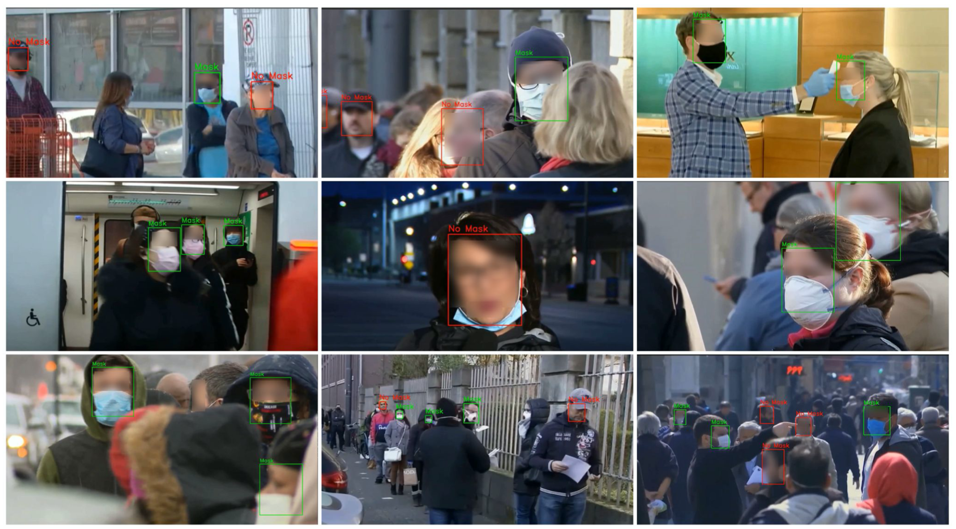
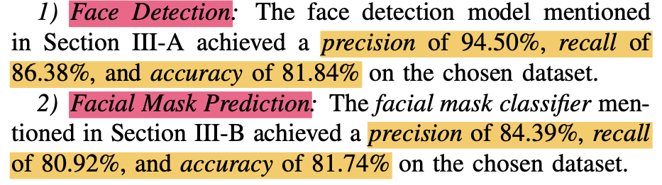
The proposed framework

Slide 9
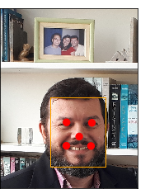
What is MTCNN?
[2]
Multi-Task Cascaded Convolutional Networks
Framework that exploits multi-task learning to integrate face detection and face alignment

Slide 10
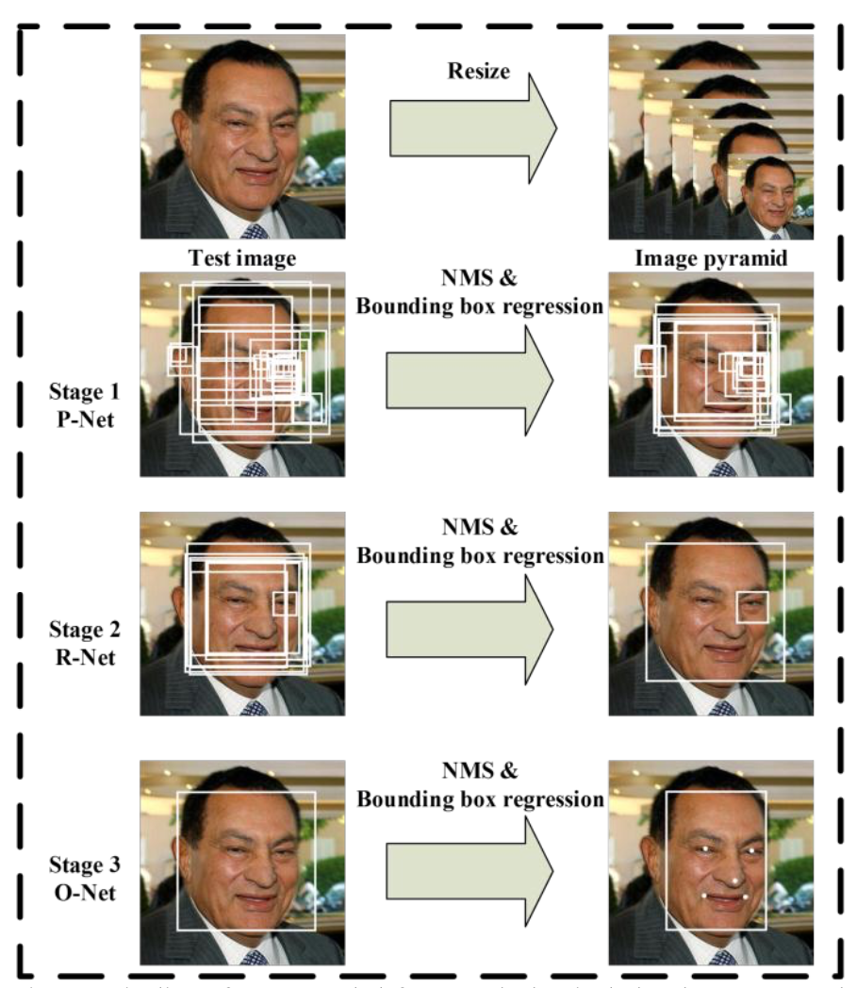
What is MTCNN?
Resize image to different scales to build an image pyramid, the input of a three-stage cascaded network

Slide 11
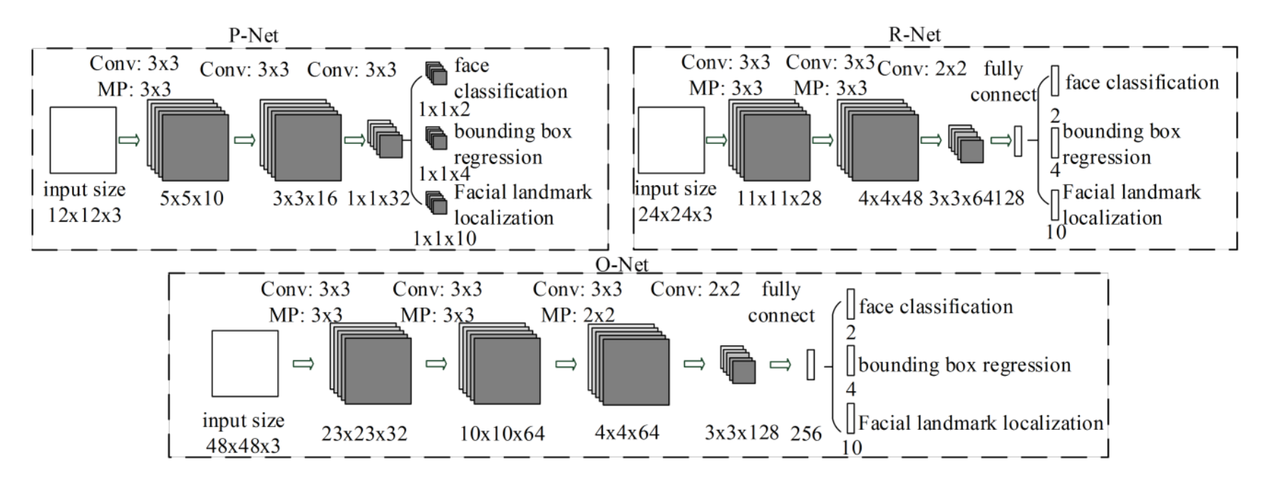
What is MTCNN?
Proposal Network (P-Net)
Fully convolutional network that predicts localization of boxes through bounding box regression and performs refinement by combining overlapping regions (NMS)

Slide 12
What is MTCNN?
Refine Network (R-Net)
Convolutional neural network that rejects a large number of false candidates, performs calibration with bounding box regression and NMS. Outputs are presence of face, bounding box and facial landmarks

Slide 13
What is MTCNN?
Output Network (O-Net)
More powerful convolutional neural network that refines the results and outputs five facial landmarks positions: eyes, nose and mouth regions

Slide 14
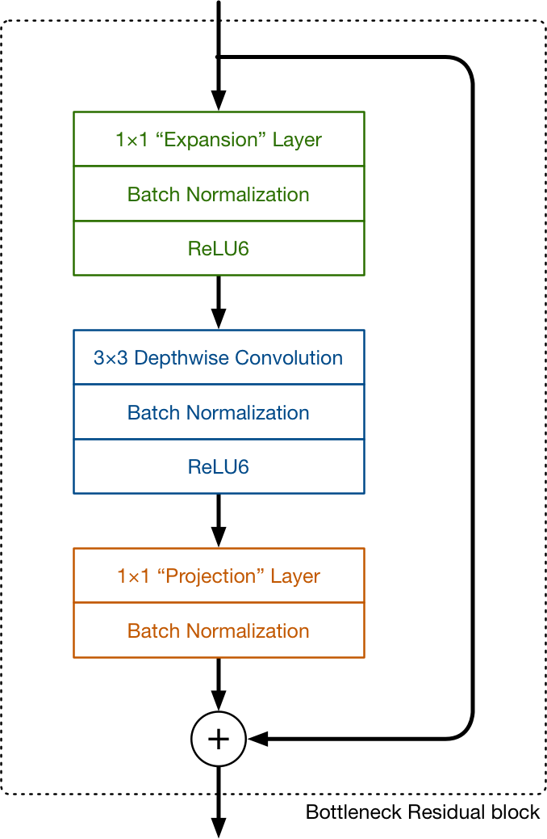
What is MobileNet?
[3]
Feature extractor for object detection and segmentation
Neural architecture that runs very efficiently on mobile devices
Convolutional layers in MobileNetV2 are replaced by depthwise separable convolutions

Slide 15
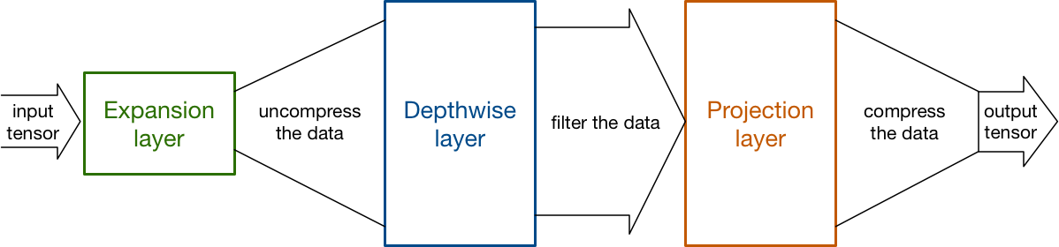
What is MobileNet?
Bottleneck Residual Block: it reduces the amount of data that flows through the network

Slide 16
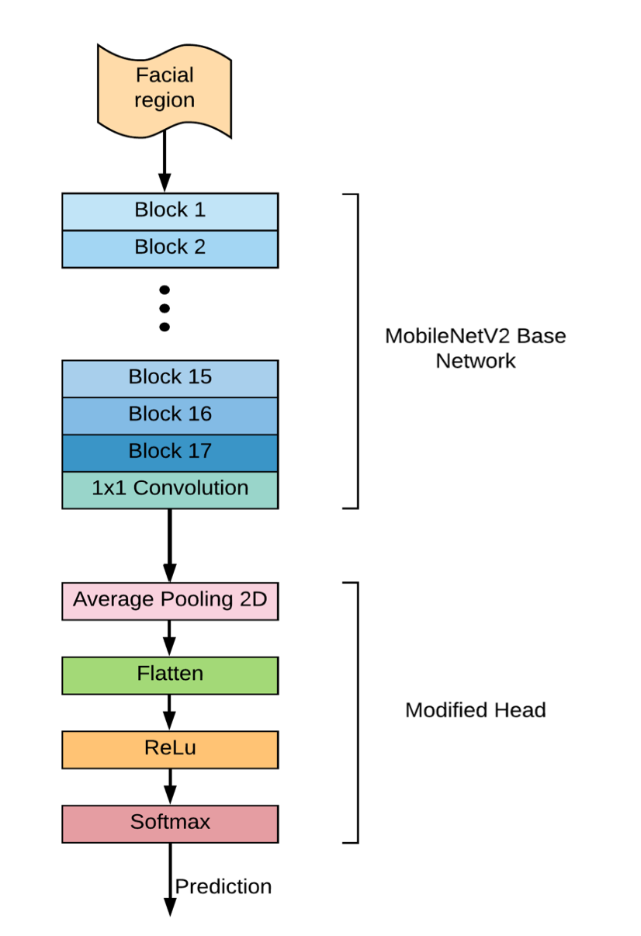
What is MobileNet?
Full architecture comprises 17 bottleneck residual blocks followed by a regular 1x1 convolution
Facial mask classifier uses 4 more layers: average pooling, flattening, ReLU activation function, softmax function

Slide 17
Project implementation

Slide 18





Technologies
Google Colab
Python libraries
Jupyter Notebook
Tensorflow
SciKit Learn

Slide 19
The dataset
[4]
We chose “Face Mask Dataset” from Kaggle
It consists of 924 images of people with and without mask
It fits our needs because it contains images taken in a wild environment (unconstrained conditions, lots of people, public places, …)

Slide 20
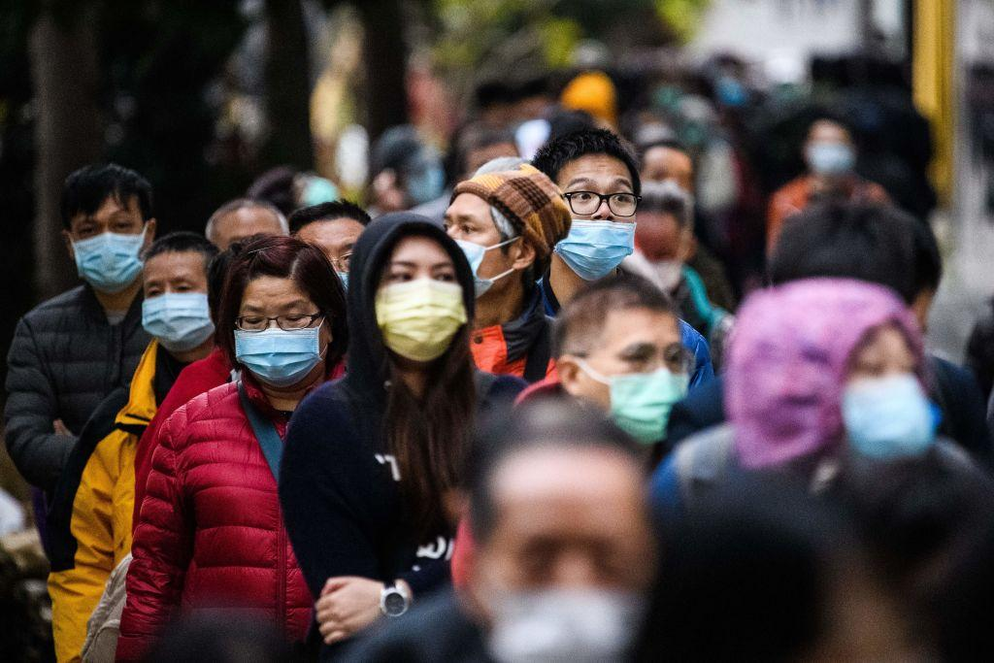
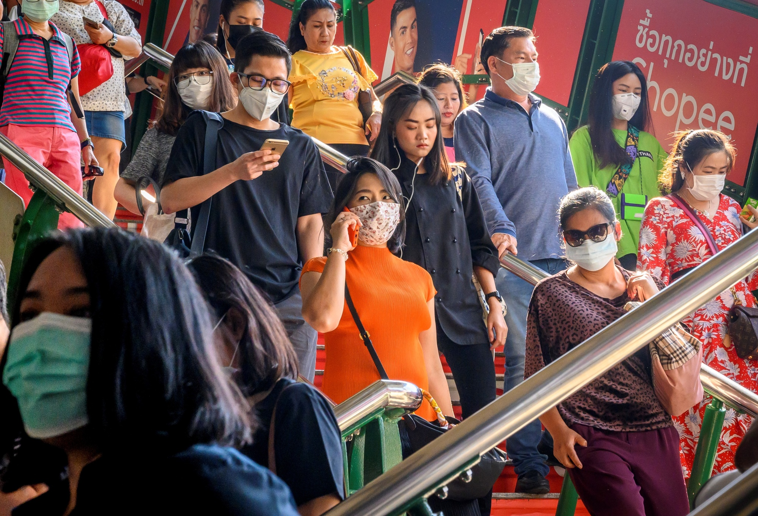
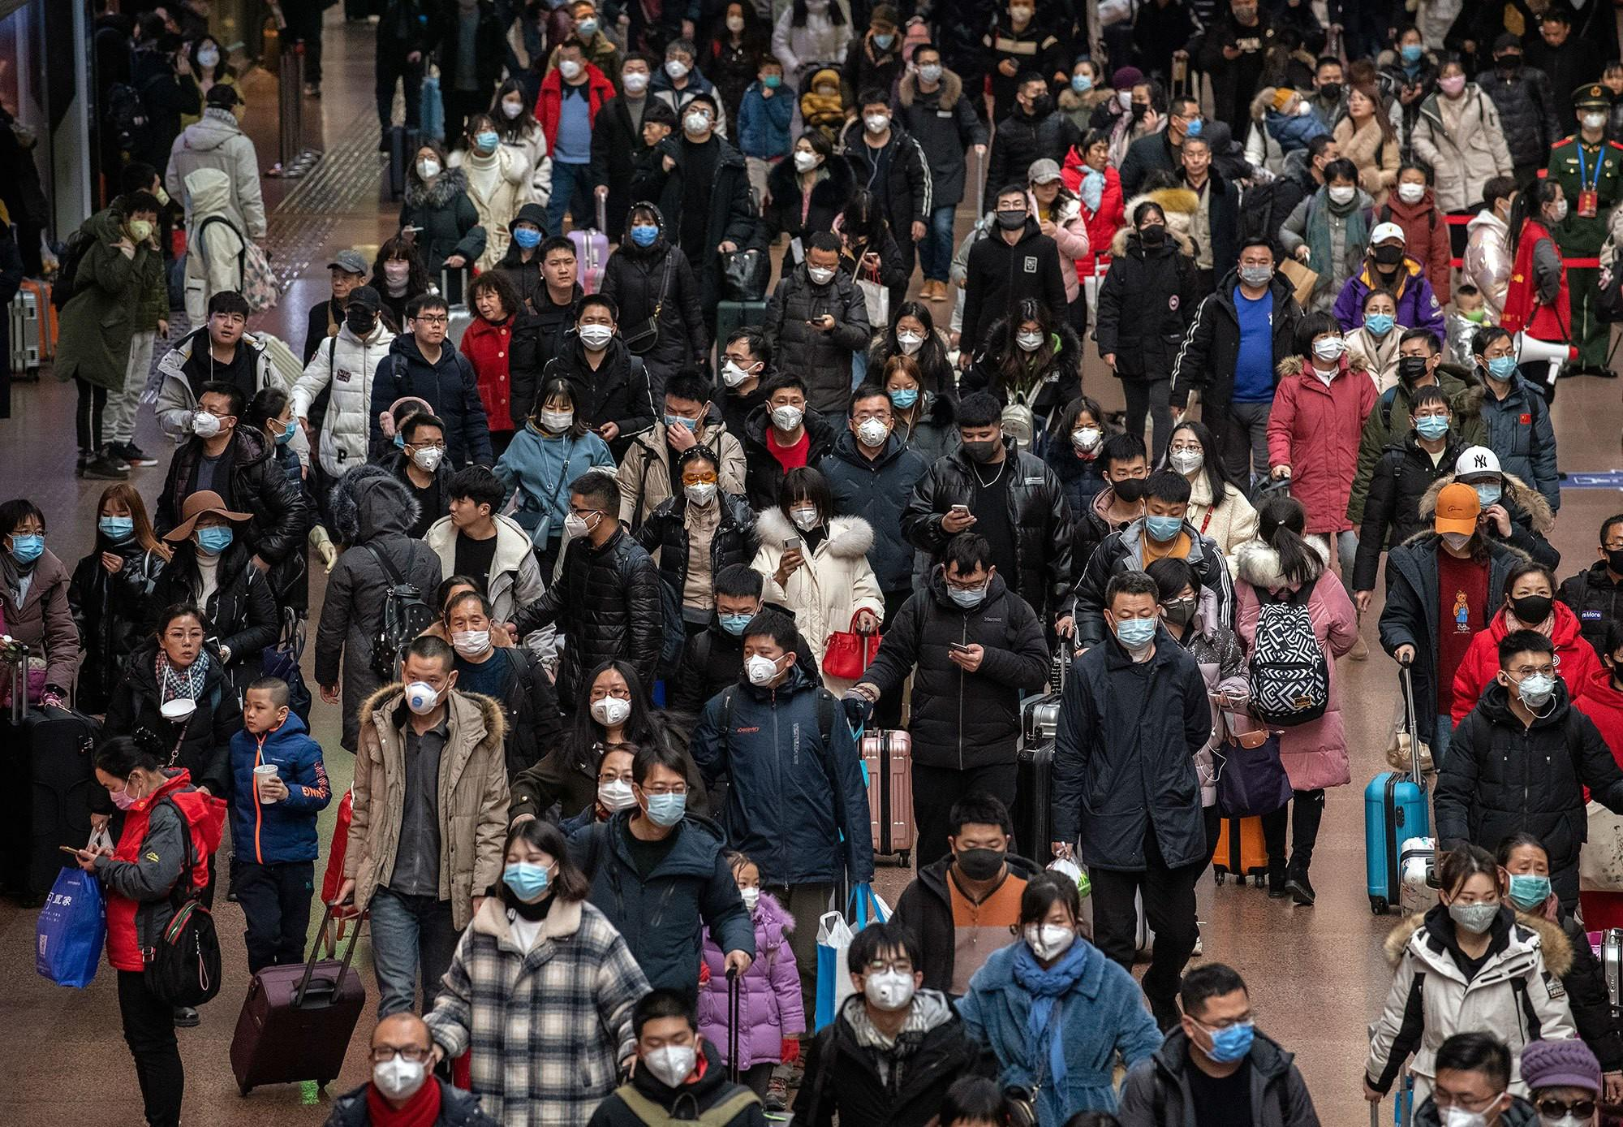
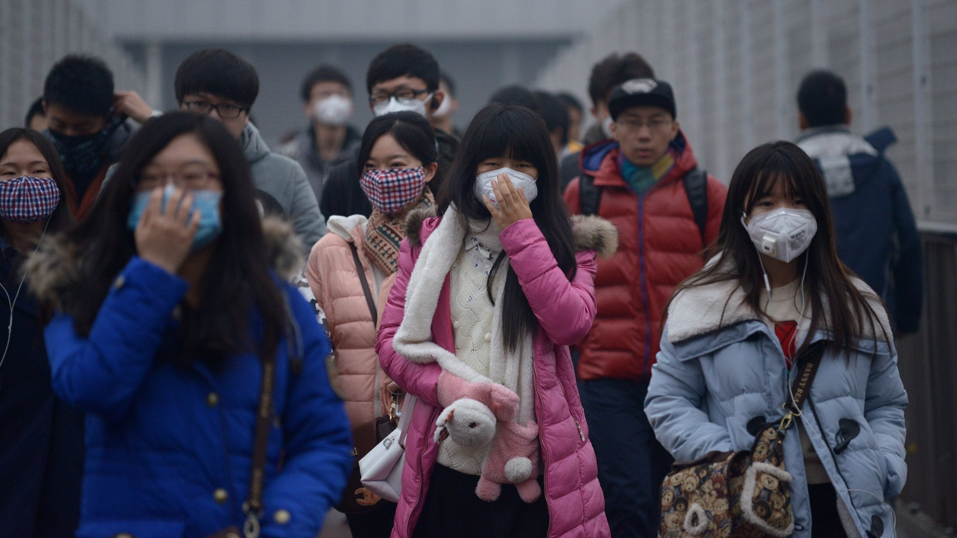
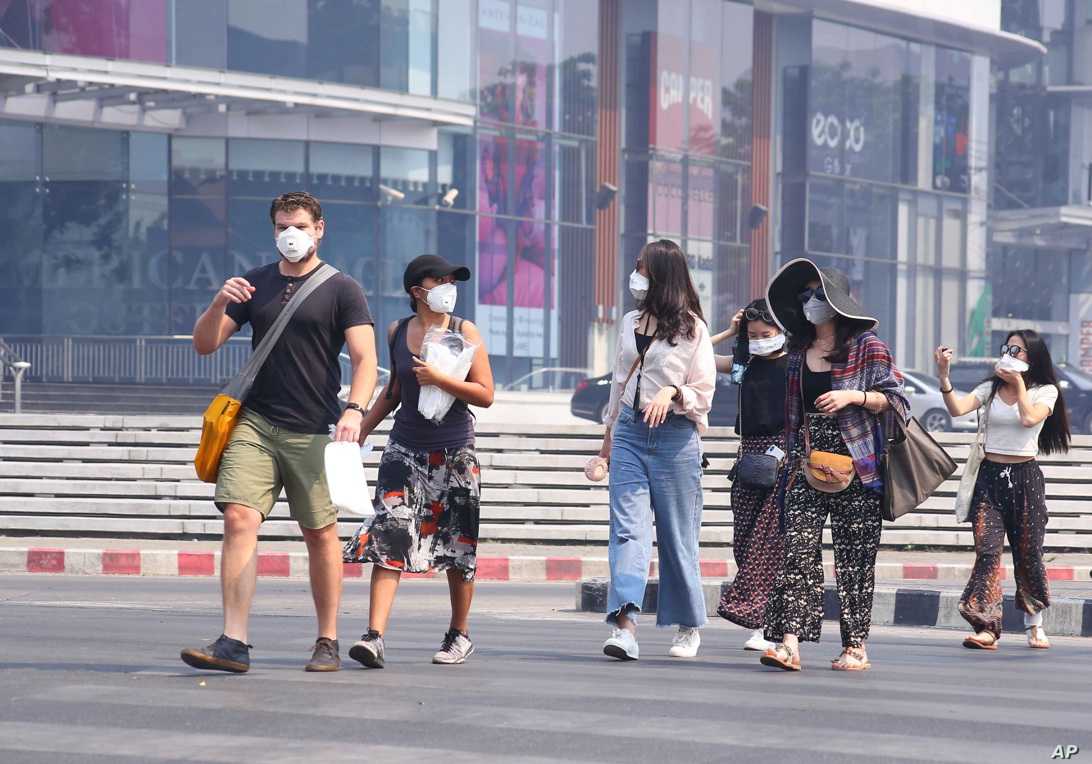
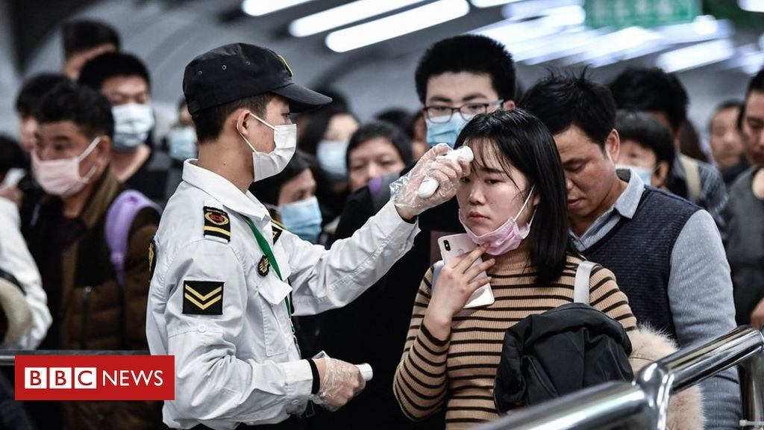
The dataset

Slide 21
YOLO format
width
(x, y)
height
1 0.626953 0.263021 0.091797 0.223958
mask
relative center coordinates of box
relative width and height of box

Slide 22
Importing the dataset
imagePaths = list(paths.list_images(dataset))
for n in range(0, len(imagePaths)):
images.append(image)
x = int(rel_x * img_w)
y = int(rel_y * img_h)
w = int(rel_width * img_w)
h = int(rel_height * img_h)
a = [x - int(w/2), y - int(h/2)]
b = [x + int(w/2), y - int(h/2)]
c = [x + int(w/2), y + int(h/2)]
d = [x - int(w/2), y + int(h/2)]
boxes[n].append([a, b, c, d])
list image paths
populate images array
}
calculate absolute values
}
calculate position of 4 box vertices
populate boxes array

Slide 23
Introduction
Face Detection with MTCNN Model
Comparison between Python and Pytorch Libraries
How do we measure the performance of face detection model?(threshold = 0.8)
Visual examples of Ground Truth and MTCNN Detection Comparison
Face Detection Evaluation
Concept of IOU, TP, TN, FP, FN
Implementation
Result of Evaluation
Training MobileNet V2 Model
Why We Choose another dataset
Transfer Learning
Preprocessing
Show the result

Slide 24
Comparison between Python and Pytorch MTCNN Libraries
Speed on detection from a sample of 1000 images:
Python -> (using CPU) Speed: 6m 54s
Pytorch -> (using GPU) Speed: 28s
Analyzing particular cases
Since both modules have been implemented referring to the same architecture (Multi-task Cascaded Convolutional Networks), we hypothesize that a difference in the detection between the two could lie in the fact that they have been trained with different datasets.
MTCNN Python module may have been trained with images of faces that also present noise situations (presence of different lighting, masks, ...). Which resulted in better detection performance.

Slide 25
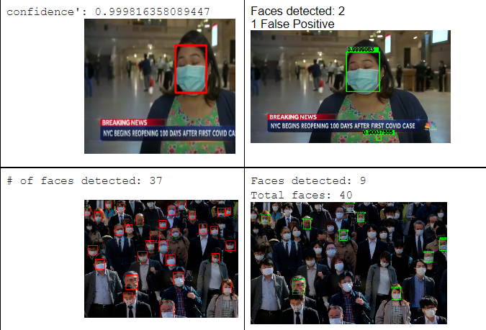

Slide 26


Slide 27
How do we measure the performance of object detection model?(threshold = 0.8)
To convert the probabilities to detect faces or not, a threshold is used. When the probability is equal to or above the threshold, the sample is classified as one class. Otherwise, it is classified as the other class.
Let's agree that a sample is detect a face if its probability is above or equal to the threshold. Otherwise, it is Not detecting.
The next block of code converts the scores into class labels with a threshold of 0.8.
Why 0.8???????????????????

Slide 28
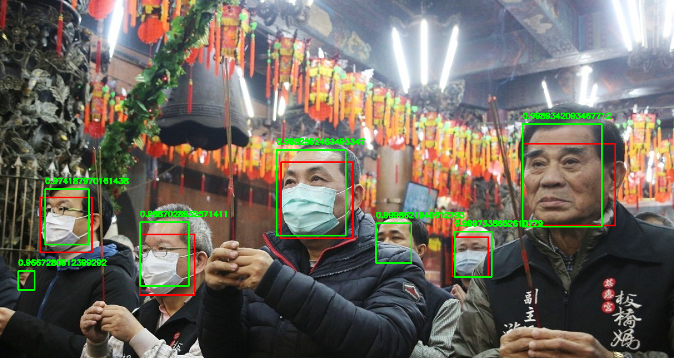
Visual examples of Ground Truth and MTCNN Detection Comparison

Slide 29
Face Detection Evaluation
Evaluation is a process that critically examines a program.
It involves collecting and analyzing information about a program’s activities, characteristics, and outcomes.
Its purpose is to make judgments about a program, to improve its effectiveness, and/or to inform programming decisions

Slide 30
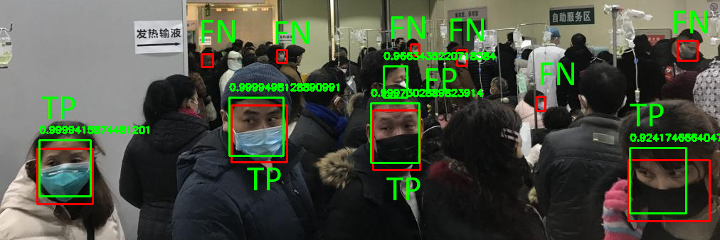
Concept Of TP, TN, FN, FP
False negative; Result should have been positive, but is negative.
False positive; Result should have been negative, but is positive.
True positive; Result should have been positive and is positive.
True negative; Result should have been negative and is negative.
Generally, in object detection all metrics that contain TN are ignored, because there would be to many TN, which makes the metric difficult to use.

Slide 31
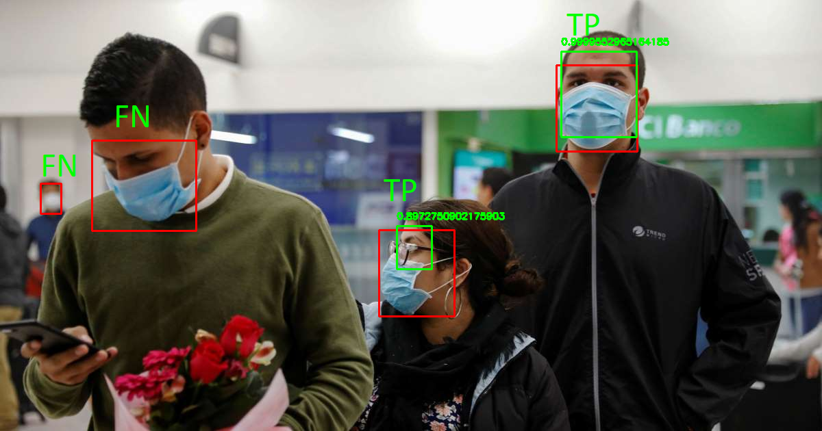
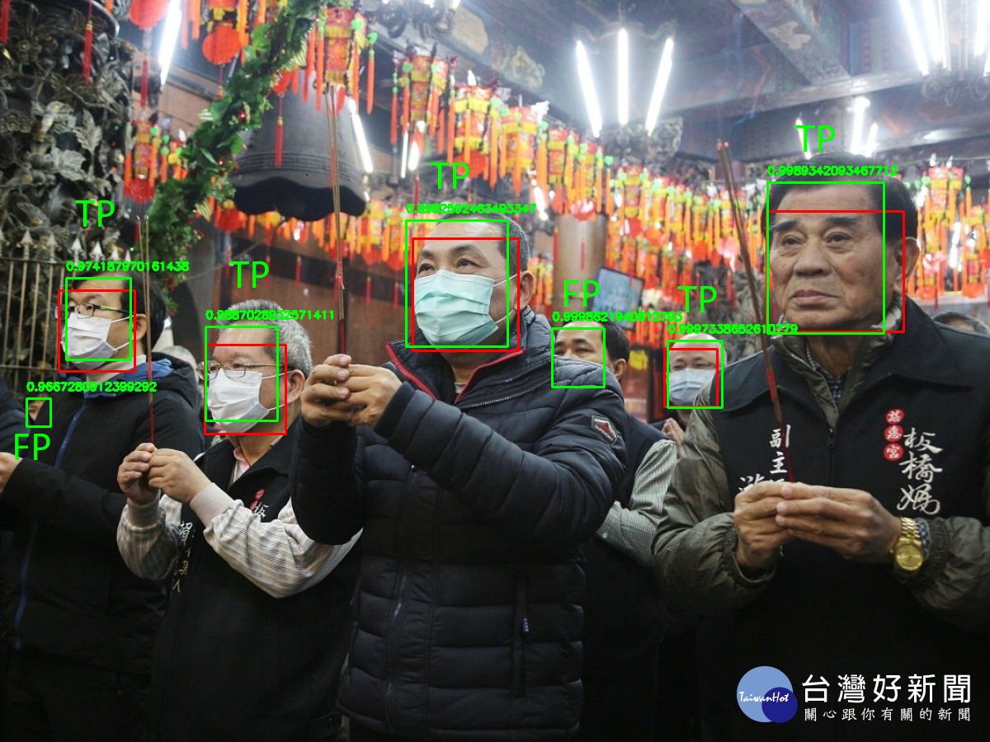
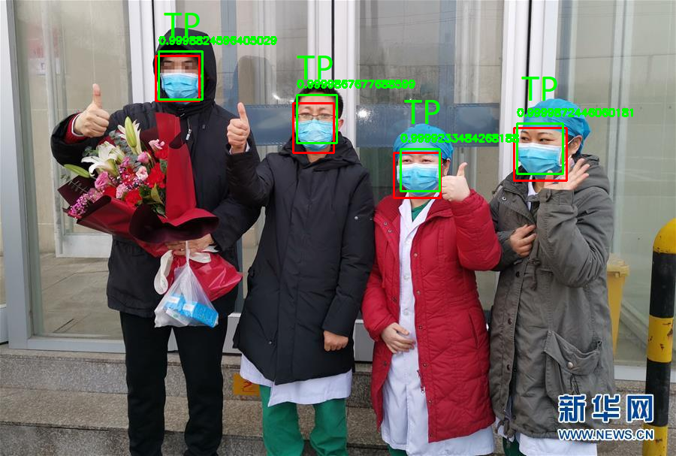
Pictures

Slide 32

Concept of IOU
If IOU ≥0.4, classify the object detection as True Positive(TP)
If IOU <0.4, then it is a wrong detection and classify it as False Positive(FP)
When a ground truth is present in the image and model failed to detect the object, classify it as False Negative(FN).
True Negative (TN): TN is every part of the image where we did not predict an object. This metrics is not useful for object detection, hence we ignore TN.

Slide 33
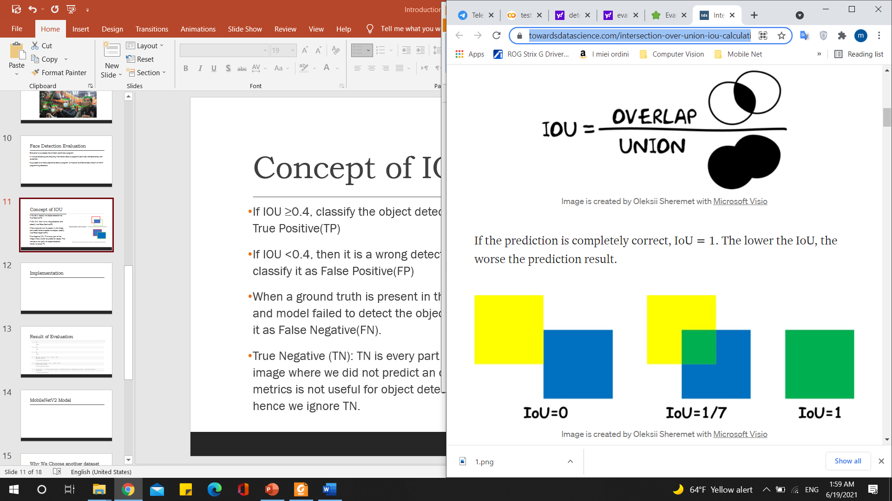
Implementation

Slide 34
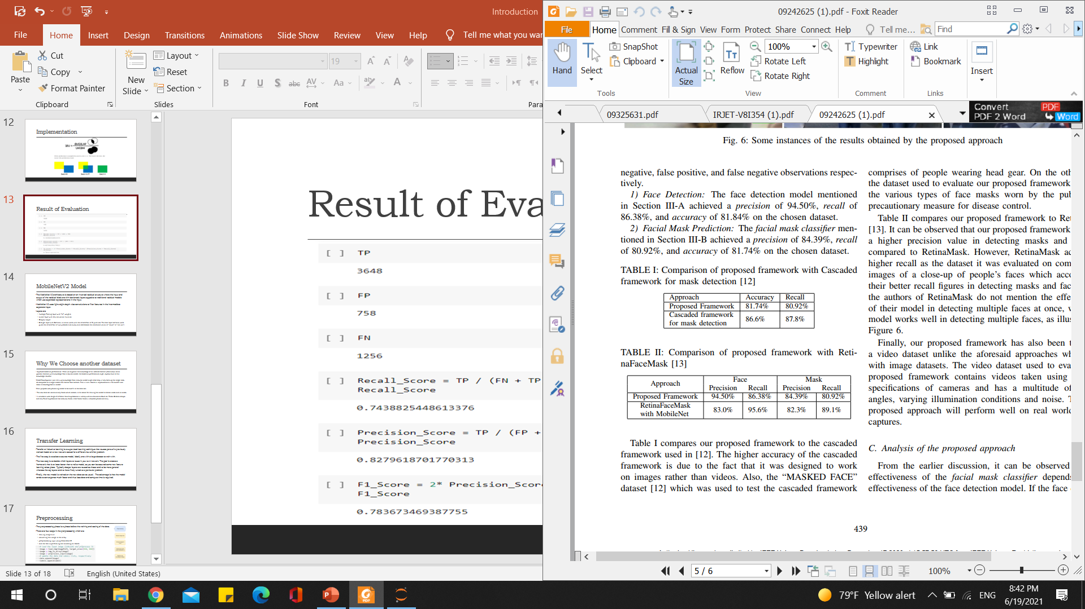
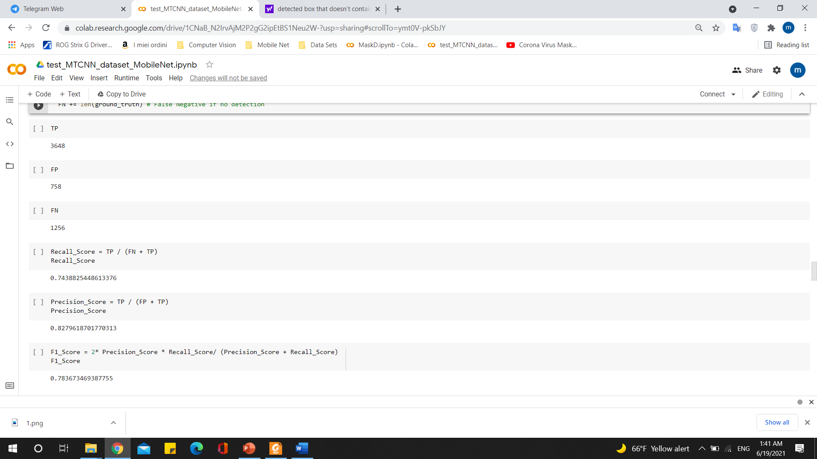

Result of Evaluation
Accuracy?

Slide 35
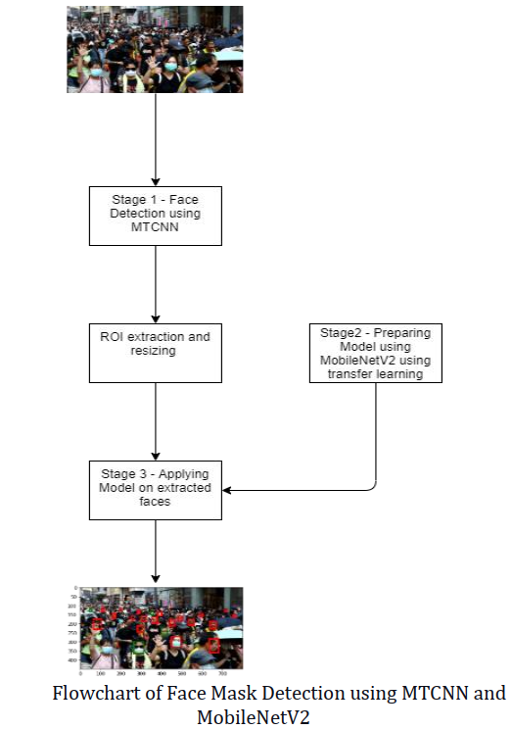
Training MobileNet V2 Model
Our approach according to International Research Journal of Engineering and Technology (IRJET)
Train Deep learning model (MobileNetV2) using Transfer Learning(Another Dataset)
Find ROI using MTCNN
Apply mask detector

Slide 36
Transfer Learning and the advantages
Transfer or inductive learning is a supervised learning technique.
The first step is to select a source model, ideally large dataset to train with.
The next step is to decide which layers to reuse in your own network.
Finally, the new model is trained on the new data set.
Advantages:
Improved performance
Model-development time
Main purpose was preventing model to be overfit to the data set we want to test.

Slide 37
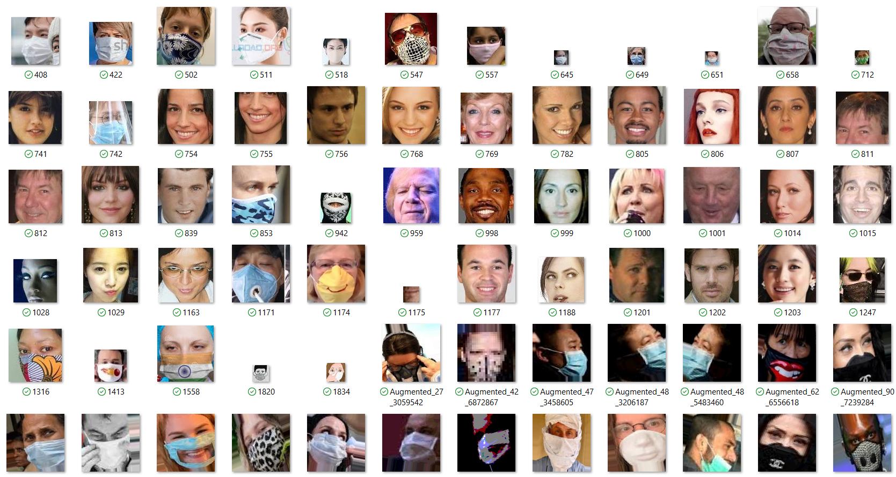
Why We Choose another dataset
The new data set(Kaggle) contains only faces(without background) which makes it a lot easier for training the model to detect mask and no mask faces.
It includes a wide range of different facial expressions such as: side view faces, tilted faces and etc.
It is a large dataset: Face Mask Detection ~12K Images Dataset

Slide 38
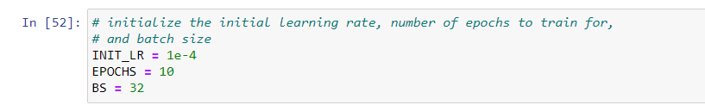
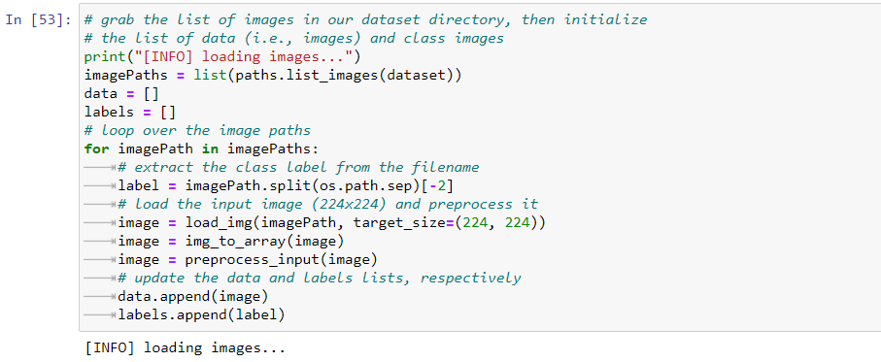
Training MobileNet V2 Model
initialize the initial learning rate, number of epochs,batch size:
grab the list of images in our dataset directory, then initialize the list of data and class images:

Slide 39
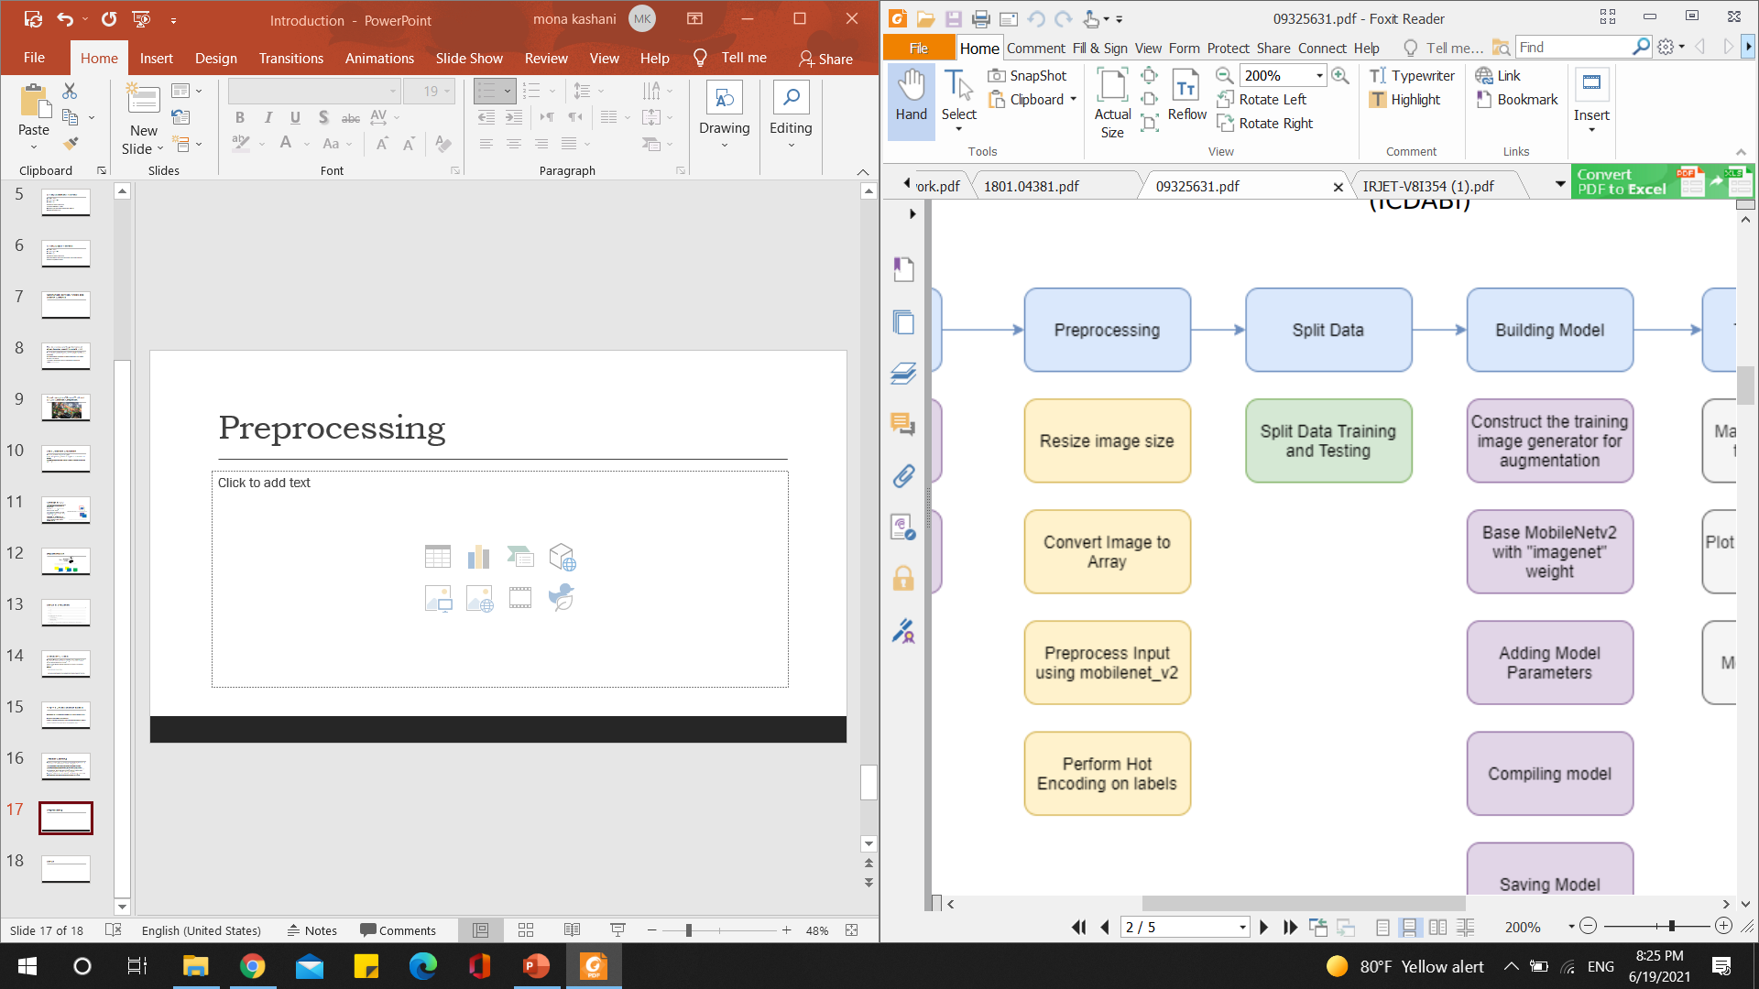
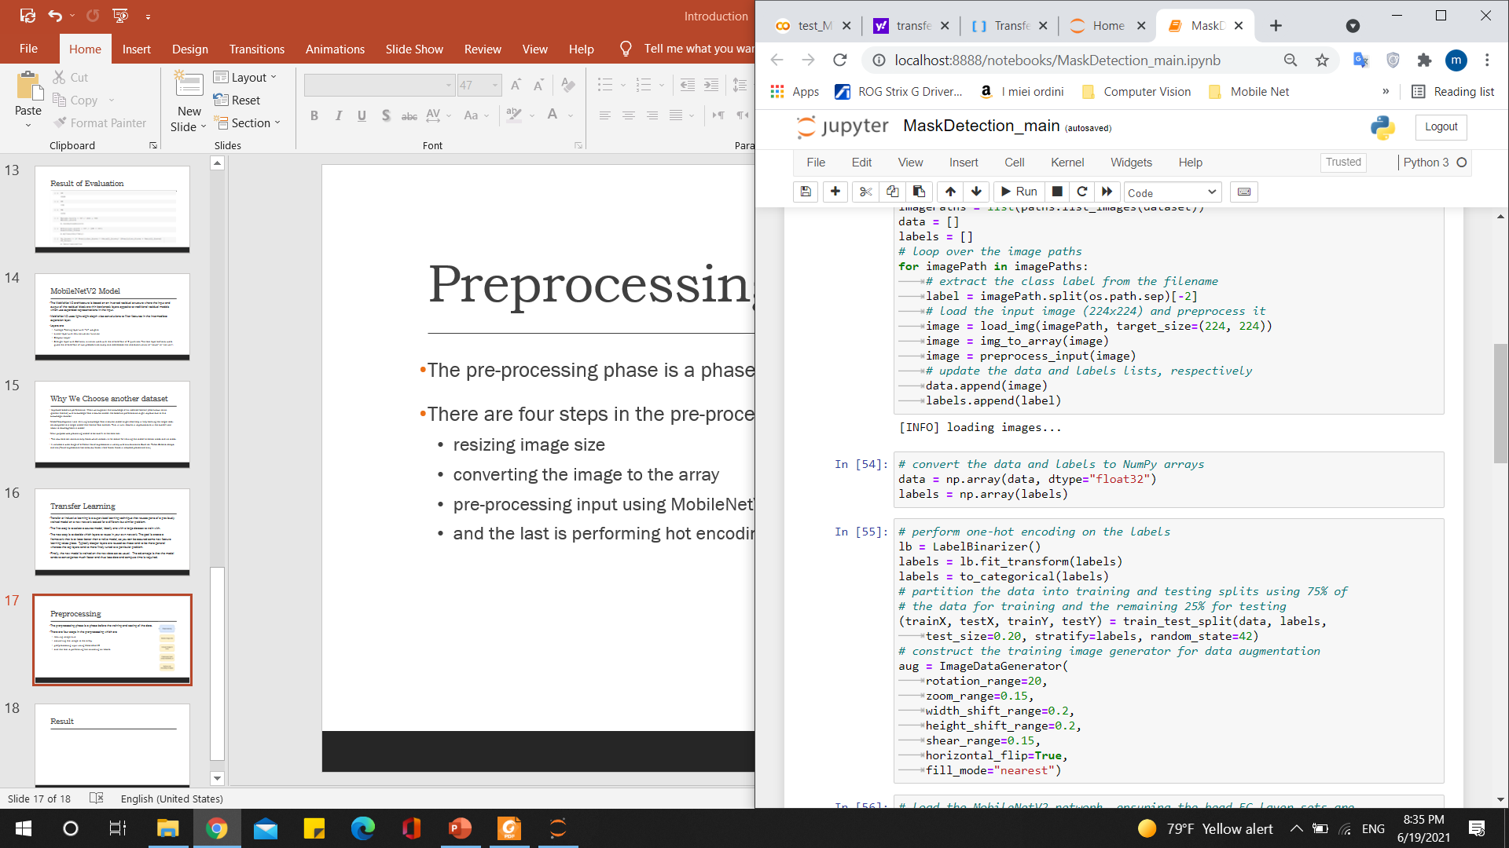
Preprocessing
The pre-processing phase is a phase before the training and testing of the data.
There are four steps in the preprocessing which are:
resizing image size
converting the image to the array
pre-processing input using MobileNetV2
and the last is performing hot encoding on labels

Slide 40
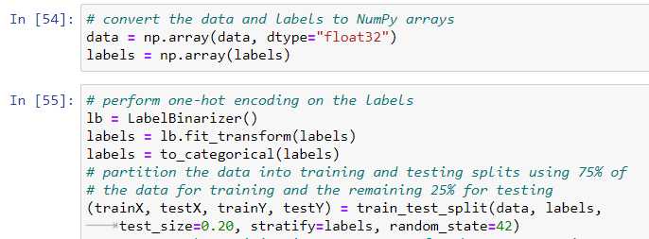
convert the data and labels to arrays and
perform one hot encoding on the labels

Slide 41
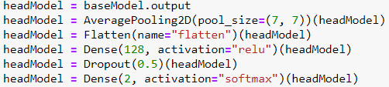
load the MobileNetV2 network, Ensuring the head FC layer sets are
construct the head of the model that will be placed on top of the the model:
place the head FC model on top of the base model:(The actual model we train)

Slide 42
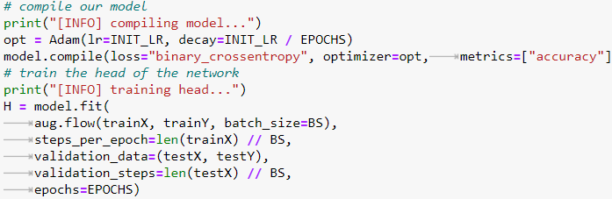
Compile the model and train the head of the network

Slide 43
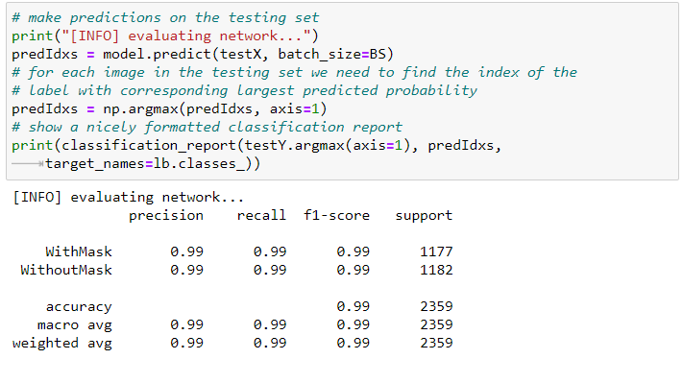
Make Predictions on the testing set and show a nicely Formatted Classification report

Slide 44
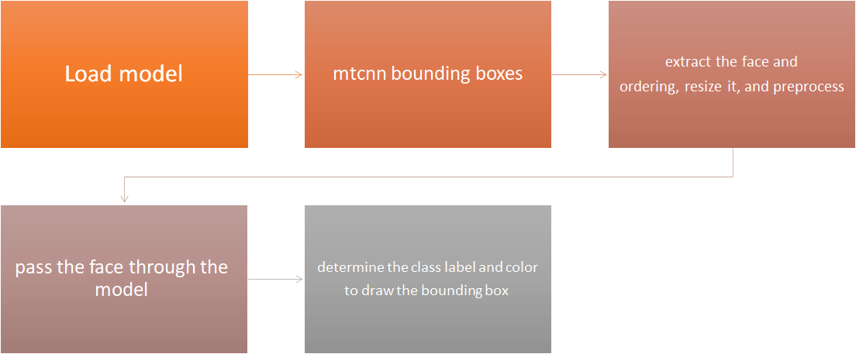
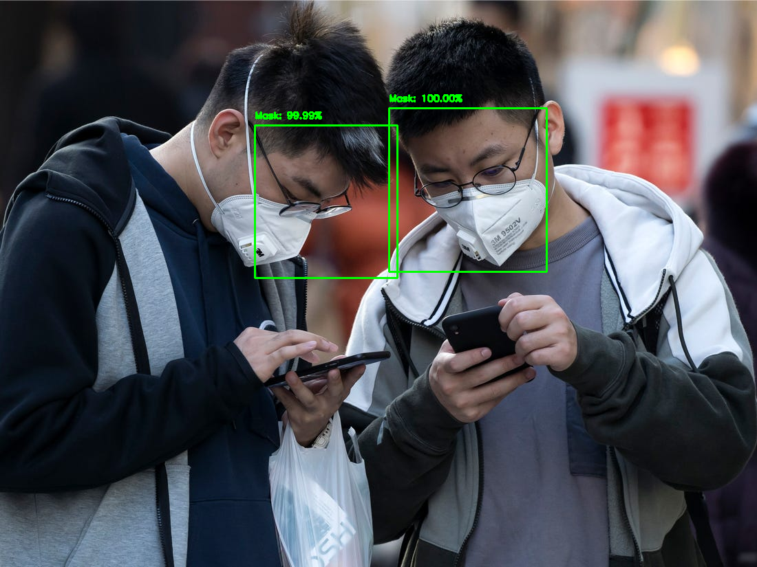
Use model resulting from training MobileNetv2 (showing an example)

Slide 45
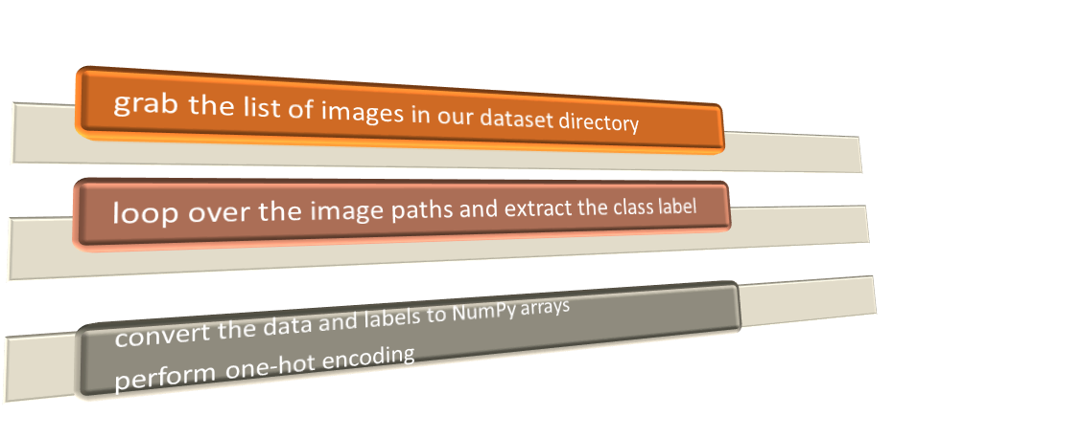
Performance evaluation of model
After creating new dataset by extracting faces from original dataset, we perform labelization of the dataset: test set of 100 mask images and 100 non mask images

Slide 46
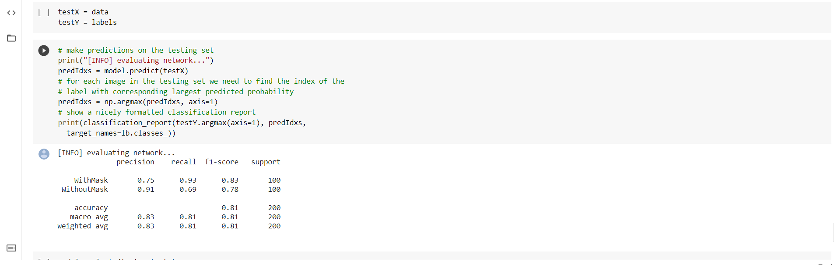
Result of evaluation (similar to paper)

Slide 47
Implement an application to use the algorithm
Webcam usage:
Since Colab is running in your browser, you'll want to use web APIs to access local hardware like a camera
go to the google colab
creat a new nootebook
click snippet and click camera capture
Run the script

Slide 48
Offline mask detection while using webcam
start taking picture
start_Execution()
get_status_Execution()
sequence of images
folder of images
each image save to folder in order
apply mask detection model
convert images to video

Slide 49
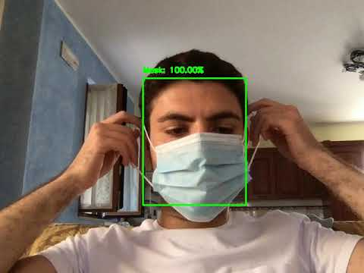
Testing offline webcam

Slide 50
Online mask detection while using webcam
this loop is repeated till end of capturing
start take picture
apply mask detection model after taking picture on pic
show each image

Slide 51
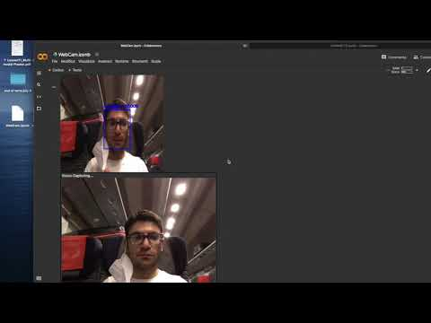
Testing online webcam

Slide 52
Conclusion and final considerations
In this work we tried a new approach for detecting face masks:
A highly effective face detection model is used for obtaining facial images and cues
The resulting approach is robust and is evaluated on a chosen dataset for this work
The effectiveness of the facial mask classifier largely confides on the ability of the face detection algorithm to accurately identify faces in images taken in wild environments.
Possible improvements:
Consider video footage taken from actual public places

Slide 53
Thank you for your attention!

Slide 54
References
[1] Deep Learning Framework to Detect Face Masks from Video Footage: https://ieeexplore.ieee.org/document/9242625
[2] Joint Face Detection and Alignment using Multi-task Cascaded Convolutional Networks: https://arxiv.org/pdf/1604.02878.pdf
[3] MobileNetV2: Inverted Residuals and Linear Bottlenecks: https://arxiv.org/abs/1801.04381
[4] Face Mask Dataset (YOLO Format): https://www.kaggle.com/aditya276/face-mask-dataset-yolo-format

